Slide 1

The Future of HEB
Northern Expansion

Slide 2
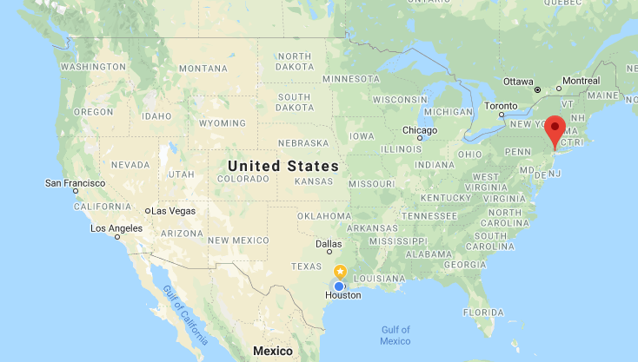
The Problem: Where In NYC Does The First HEB Northern Expansion Location Go?
NYC chosen due to population density
Manhattan chosen as area due to ‘flagship’ potential’
But where in Manhattan?

Slide 3
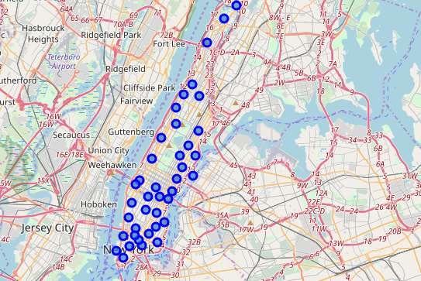
Using data from The New York City Department of Planning, 40 Manhattan ‘Neighborhoods’ identified
Data uses centriods to locate neighborhood population centers
This data set addresses population density and provides a naming framework

Slide 4
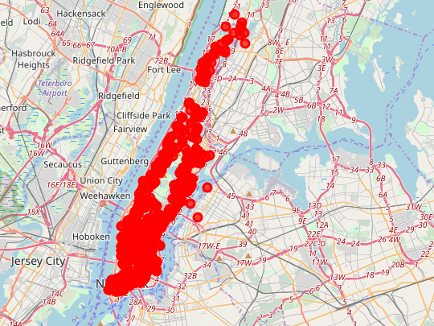
Laying Foursquare Data on The Neighborhoods, 1247 competitors identified
Foursquare data uneven in terms of reporting grocery stores
There are 20 venue types, including Grocery Store and Supermarket, plus many smaller stores like bakeries and butchers

Slide 5
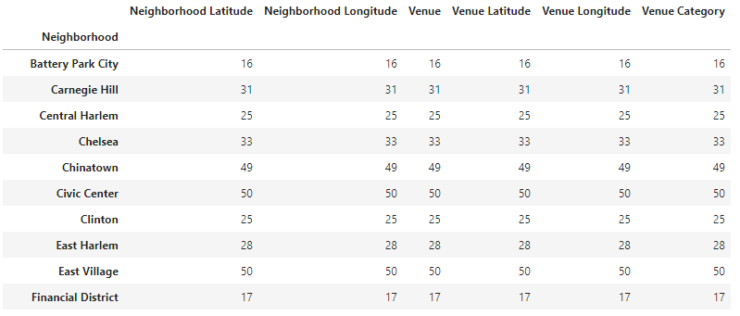
Using One Hot Encoding, venues converted to numerical data and counted
Data indicates raw number of competitors in a given neighborhood regardless of type
Variation from 13 to 50

Slide 6
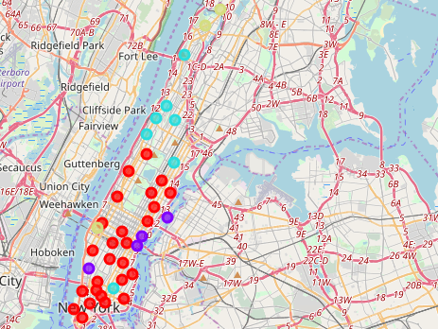
K-Means clusters venues on the top 4 most common for each neighborhood
Red dots indicate the most common competitive situation describing 26 out of 40 neighborhoods
Now, weak clusters in high density neighbors can be seen

Slide 7
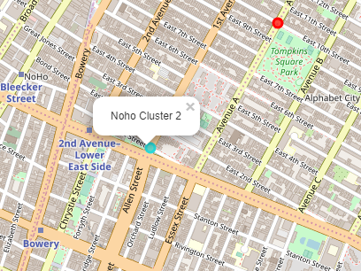
By looking at density and uncommon situations in the clusters, we see high density neighborhoods with low or weaker competitors:
Noho, The West Village, and Hudson Yards are all in highly dense neighborhoods but have lower levels of completion and are outside the default competitive configuration.

Slide 8
THANK YOU!
Any questions?
You can find me at
tom.roush@datagumbo.com

